Slide 1
DSC-680 Capstone Presentation
Tammy Lessley
August 2022

Slide 2
Overview
Introduction
Literature Review
Data Cleansing
Continuous Improvement
Machine Learning Forecasting
Project Data
Exploratory Analysis
Approach - Strategy
Wrangling
Data Event Tracking
Results
References

Slide 3
Introduction
Dairy manufacturing company
Recent implementation of Enterprise Resource Planning system
Limited data scrubbing and wrangling abilities

Slide 4
Introduction
Dairy manufacturing company
Significant Data Events over past 3 years
Altered patterns of sales data

Slide 5
Introduction
Research Goal
Find the most efficient, accurate, and effective wrangling option(s) for the given data
Efficient
~ the scenario that processed the data the fastest
Accurate
~ the scenario that produced the least amount of errors
Effective
~ the scenario that most aligned with the ‘industry metric’
Industry Metric (%) = Sum (3 weeks actuals)
/ Sum (3 weeks forecast) * 100

Slide 6
Literature Review
Data Cleansing
Continuous Improvement
Machine Learning Forecasting

Slide 7
Data Cleansing
Common Data Problems
Duplicate
Mismatched data types
Nonstandard values
Standardization of formatting – disparate sources
Missing elements
Removal
Or Input
Normalization

Slide 8
Continuous Improvement
Process Improvement
Plan, do, study, act
More team efficiencies
Less mistakes
Less rework
More accuracy
Higher quality output
Planning phase
Do iterative testing
Study the results of testing
Act = Implement those ideas that resulted in success

Slide 9
Machine Learning Forecasting
Historical Data
SARIMA
ETS
Weather
Triple Exponential Smoothing
Financial Data
Seasonal autoregressive integrated moving average
Error trend seasonal
Stationary component, trend and seasonal

Slide 10
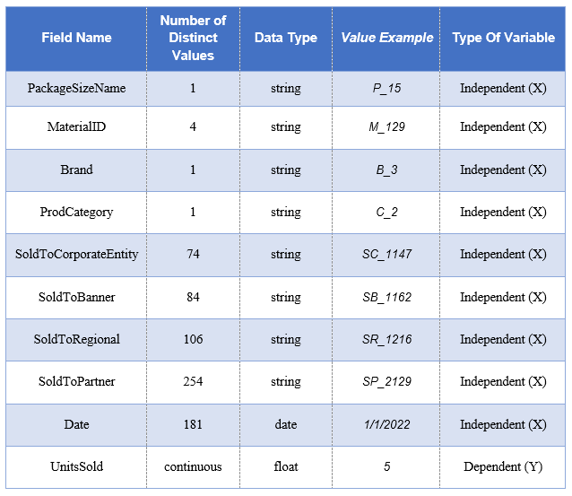
Project Data
9

Slide 11
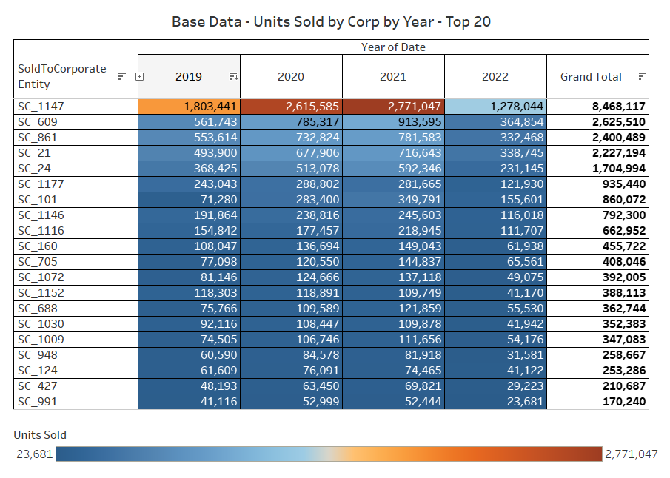
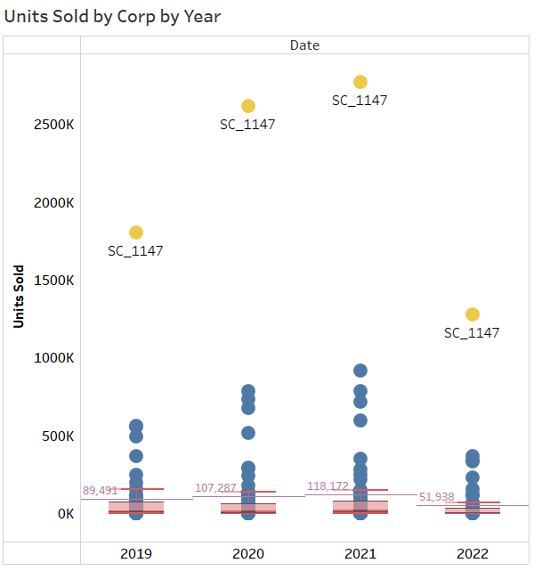
Exploratory Analysis

Slide 12
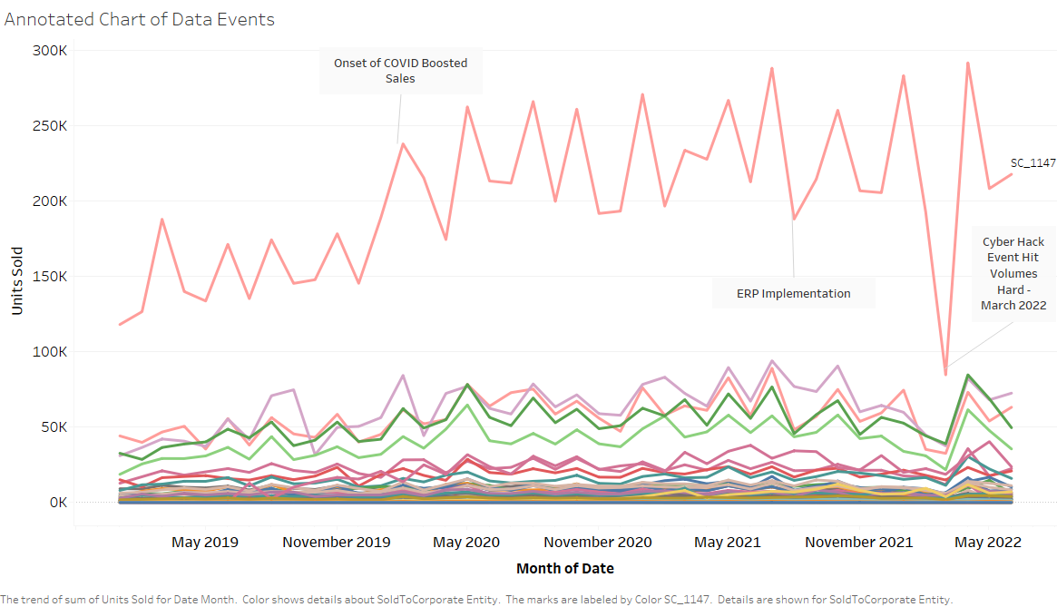
Exploratory Analysis

Slide 13
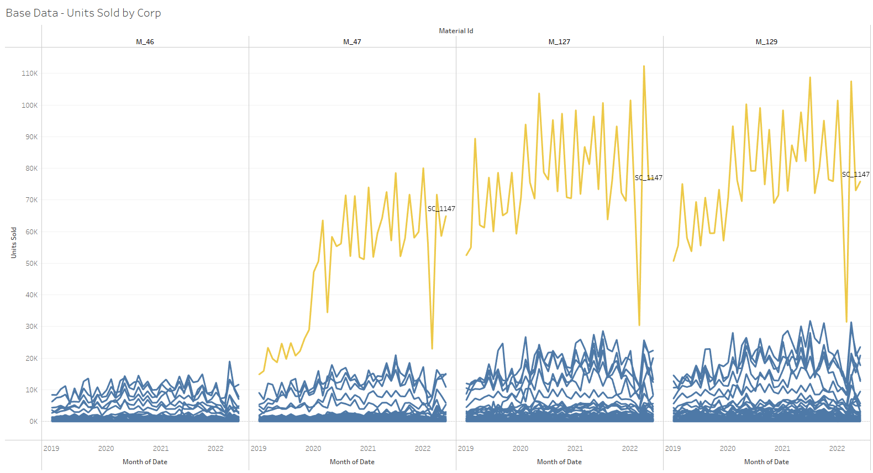
Exploratory Analysis
Corporate Entity = SC_1147
Material Id = M_129

Slide 14
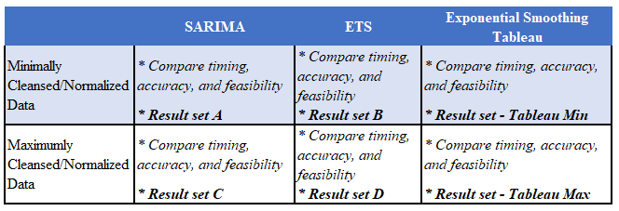
Approach - Strategy
Corporate Entity = SC_1147
Material Id = M_129

Slide 15
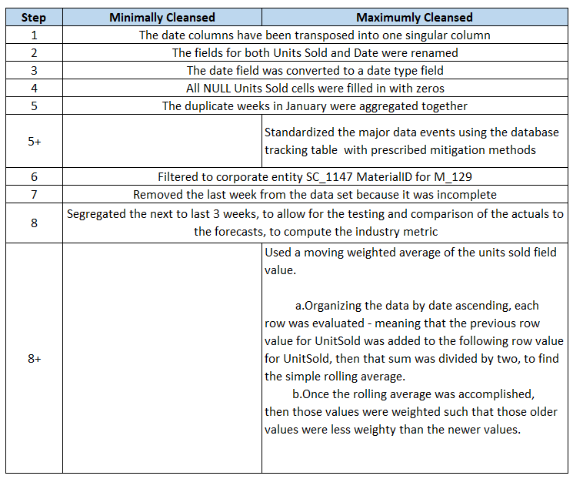
Wrangling

Slide 16
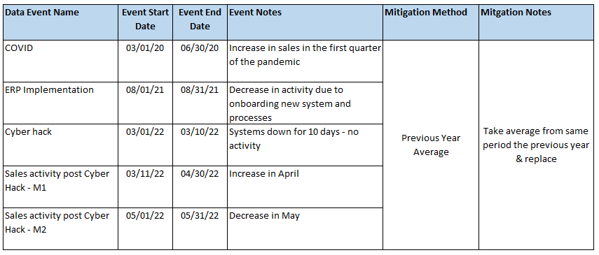
Data Event Tracking
Strategy
Database table to track all events, the timeframes, and the desired mitigation method
Functions built-in to handle each desired Mitigation Method
Create a stored procedure to pull all event data, run it through the functions to treat it accordingly and apply any aggregations necessary
Bring that normalized data back into the model for maximum benefit
Track Events
Lessons Learned
Central Repository for research and normalization mechanisms

Slide 17
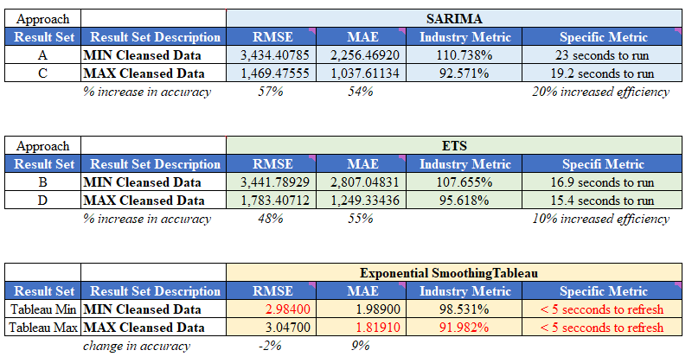
Results
RMSE = Root mean square errors
MAE = Mean absolute errors
Industry Metric (%) = Sum (3 weeks actuals)
/ Sum (3 weeks forecast) * 100

Slide 18
Results
Caveats
These results are sound for Corporate Entity SC_1147 & Material Id M_129
If these models were applied to all corporate entities, the results may not look identical to these
For any of these ideas to be productionalized, they would need far more unit testing and user acceptance testing, to see how things would behave in a dynamic daily situation

Slide 19
References
Henshall, A. (2020). How to use the Deming cycle for continuous quality improvement: Process street: Checklist, Workflow and SOP software. Process Street. Retrieved August 1, 2022, from https://www.process.st/deming-cycle/
Roldos, I. (2021). 8 effective data cleaning techniques for better data. MonkeyLearn Blog. Retrieved July 14, 2022, from https://monkeylearn.com/blog/data-cleaning-techniques/

Slide 20
Thank You
I appreciate all the effort, time, and patience of all who enabled me in this journey.
Thank you to all the professors and staff that supported and facilitated my time at Utica University.
LinkedIn https://www.linkedin.com/in/tammy-lessley-3656987/

